Slide 1
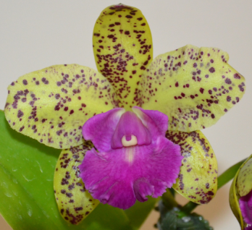
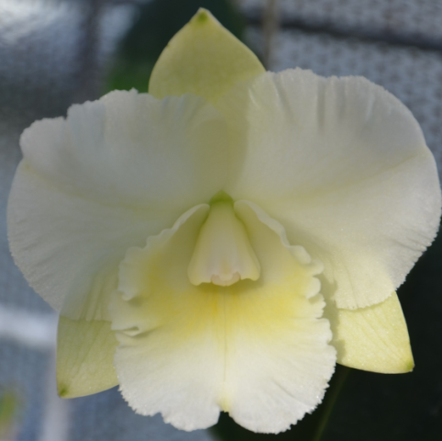
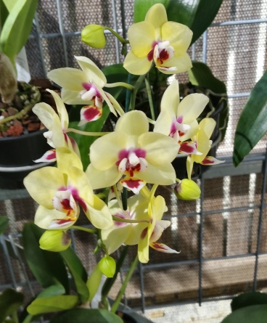
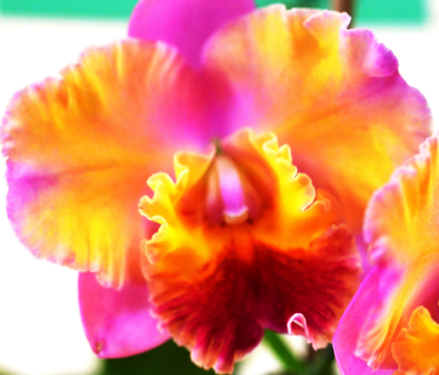
Fertilisers
ORCHIDS
And PH
Notes:
Firstly let me say that I do not have all knowledge about orchids,/ but I do have many years experience of growing orchids,/ particularly since the early 1990’s. My interest in orchids began when I was five,/ when a relative gave me my first Cymbidium. I really became quite interested in the mid nineties when I joined my first orchid society. I quickly found out,/ that you could place 5 growers in a room/ and end up with fifteen different solutions for the one problem.

Slide 2
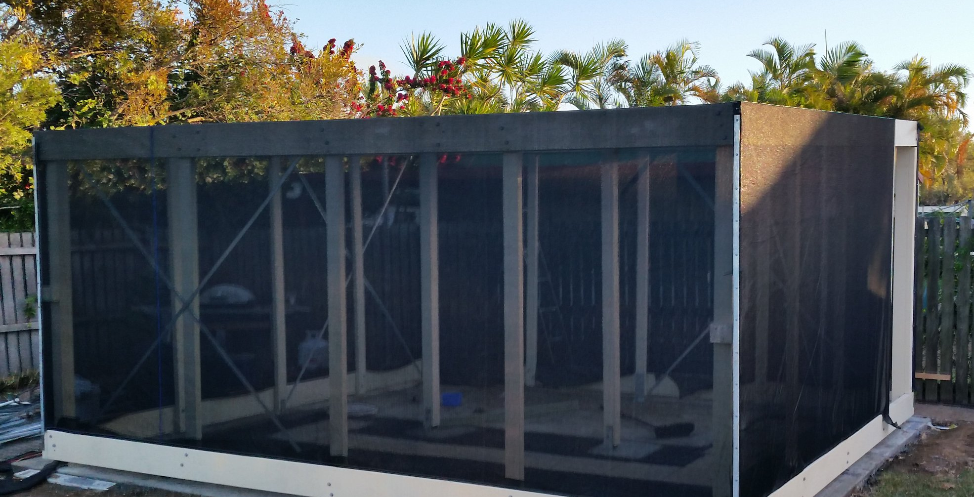

Slide 3
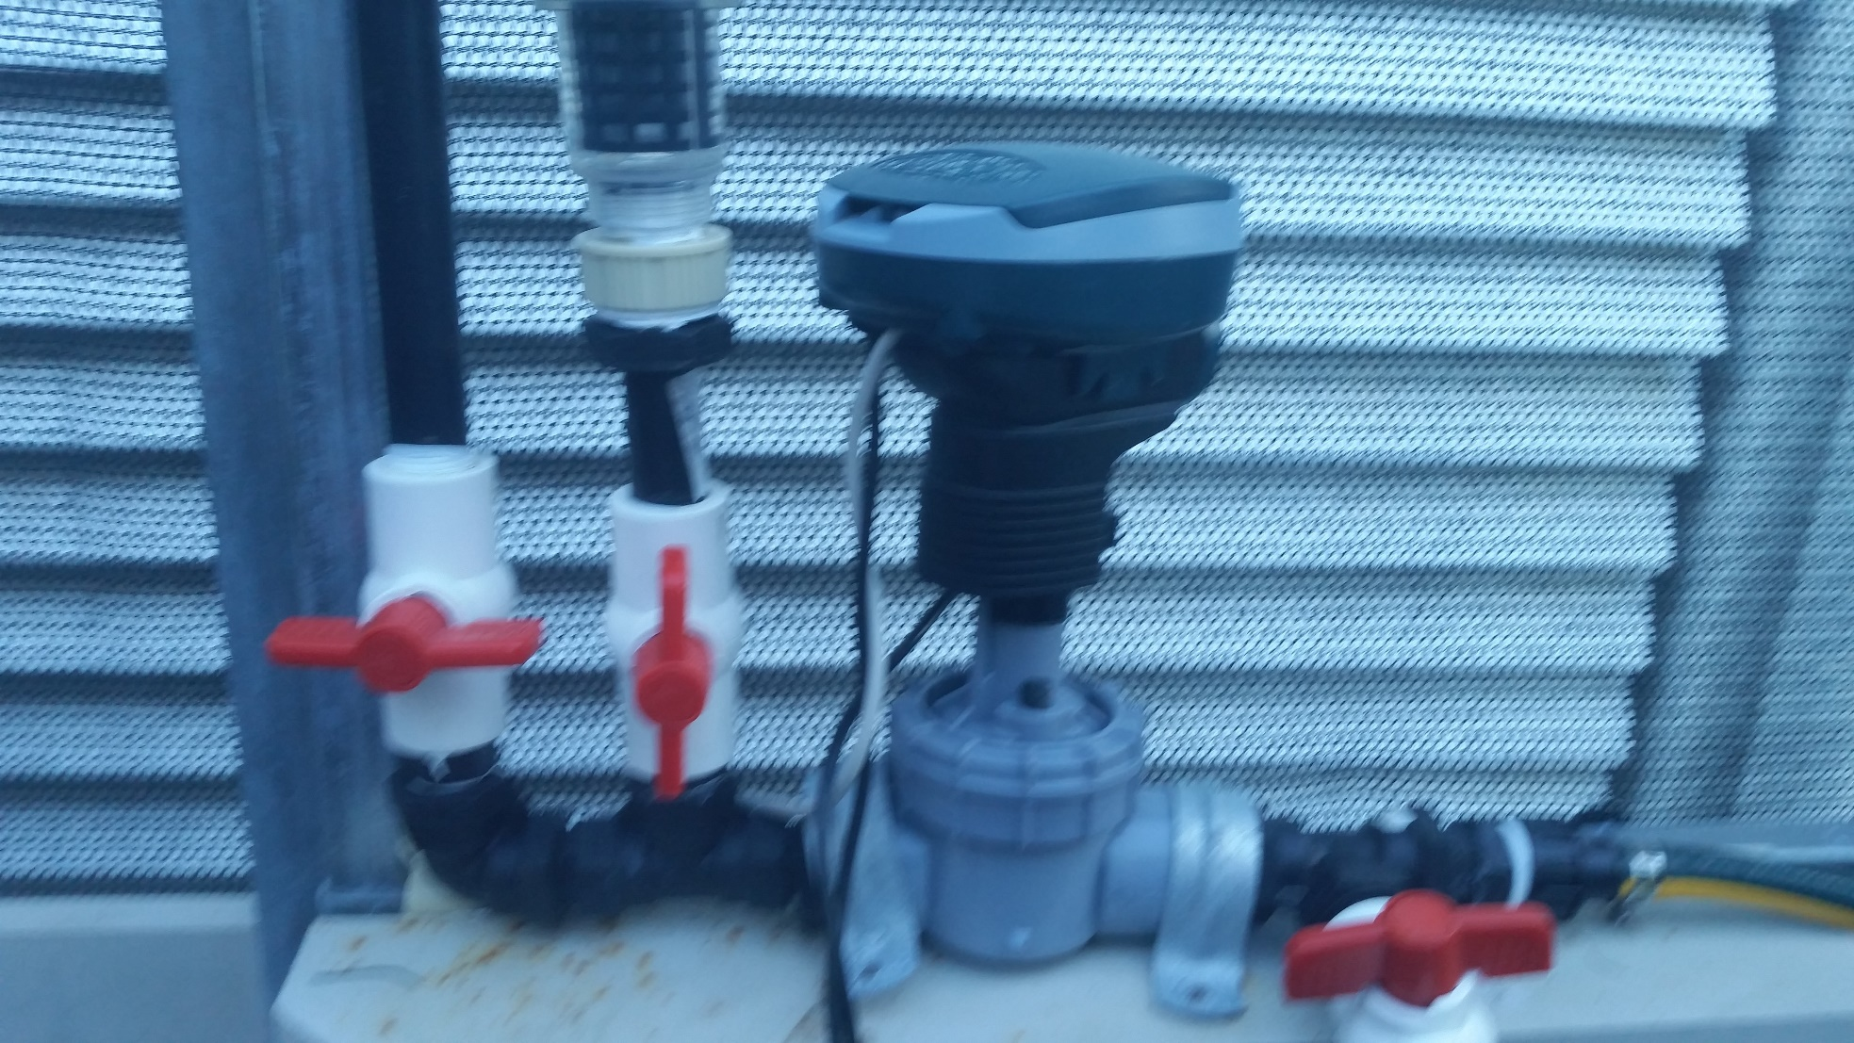

Slide 6
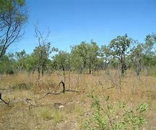
When we should have this

Slide 7
NOW IS
THE
MOST IMPORTANT TIME OF THE YEAR
“POTTING SEASON”
Notes:
Always remember that just because a plant has been awarded a FCC does not mean that you have a champion orchid in your green house.

Slide 8
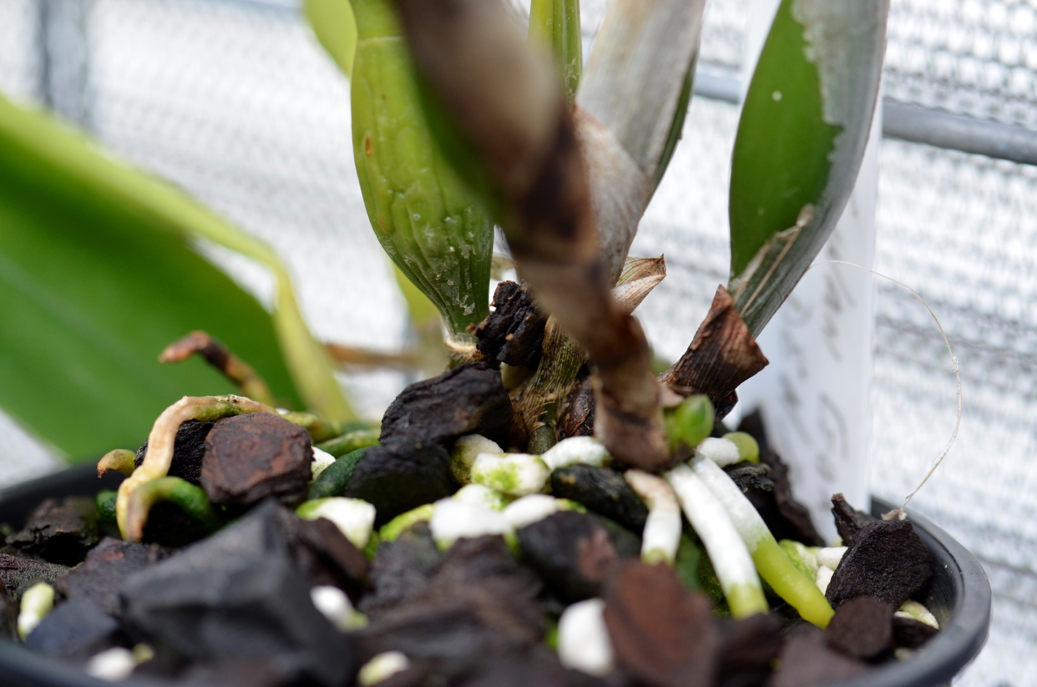
New Roots
3 to 4 cm

Slide 9
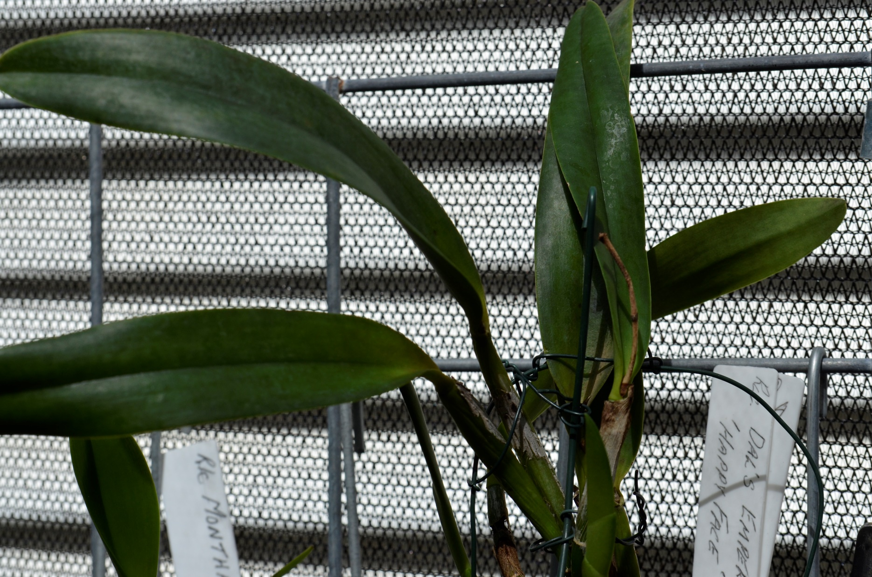
Uni- Foliate

Slide 10
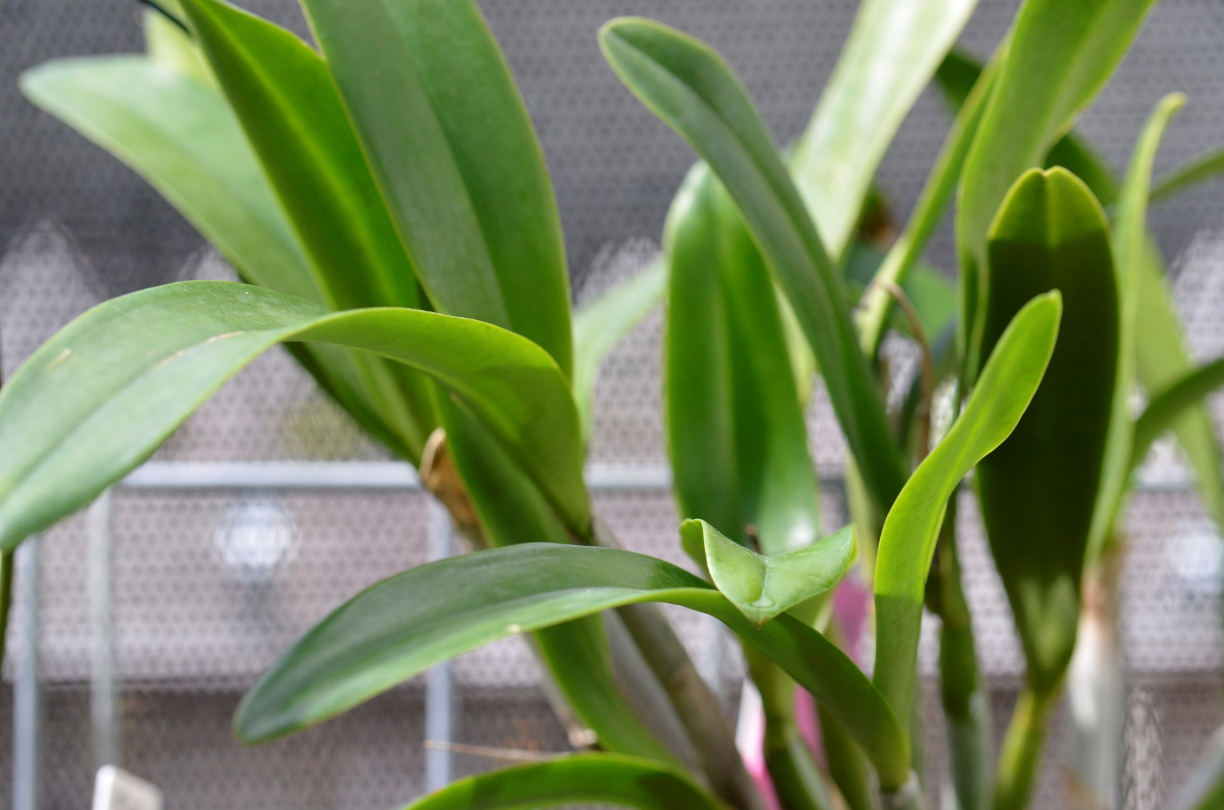
Bi- Foliate

Slide 11
POTTING MATERIALS
Can Be
Organic or mineral
Inert
Acidic
Alkaline

Slide 12
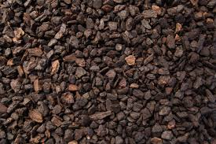
COMPOSTED
PINE BARK
(soft)

Slide 13
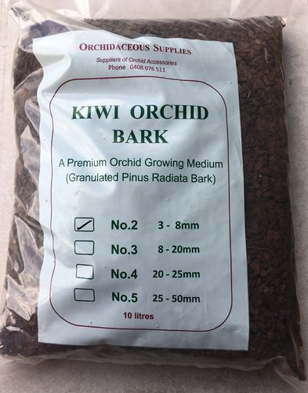
HEAT TREATED PINE BARK
(hard)

Slide 14
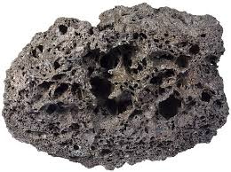
SCORIA

Slide 15
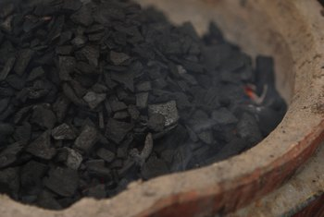
CHARCOAL

Slide 16
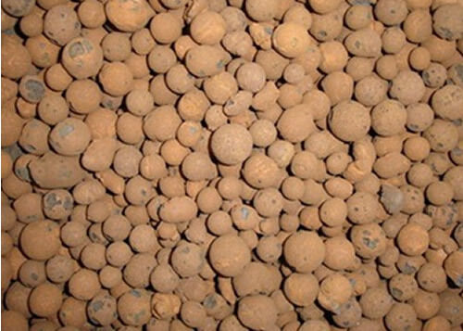
EXPANDED CLAY
BALLS

Slide 17
PERLITE

Slide 18
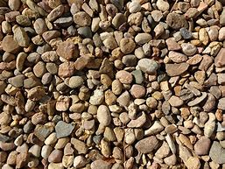
RIVER GRAVEL

Slide 19
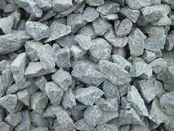
QUARRIED ROCK

Slide 20
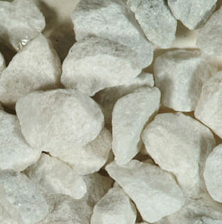
LIMESTONE
CHIPS

Slide 21
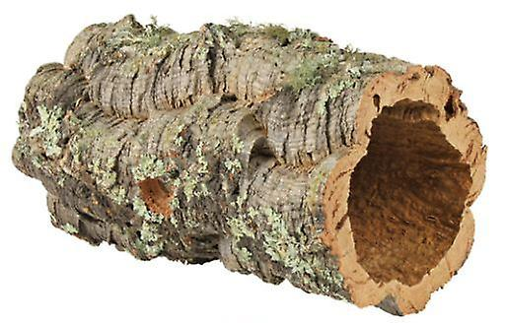
CORK,
CASUARINA,
TREE FERN, &
HARDWOOD SLABS.

Slide 22
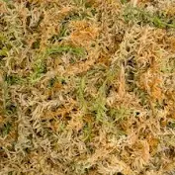
SPHAGNUM MOSS

Slide 23
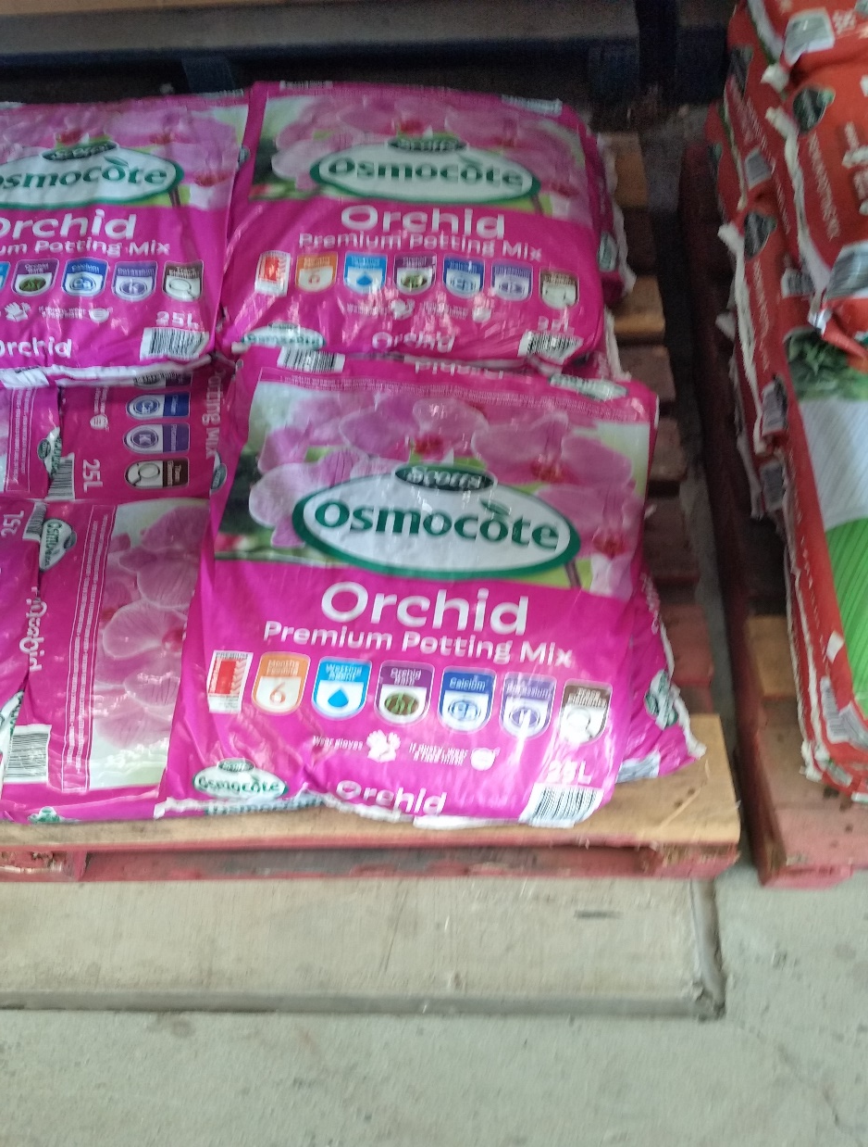
Cheap prepackaged
Bark mix.

Slide 24
MY POTTING MIX
5 Parts Bark
2 Parts Expanded Clay Balls
2 Parts Scoria
2 Parts Perlite
1 Part Charcoal

Slide 25
STERILISATION OF ALL CUTTING EQUIPMENT IS MOST IMPORTANT.
USE A SATURATED SOLOUTION OF TRISODIUM PHOSPHATE
TO STERILISE CUTTERS.

Slide 26
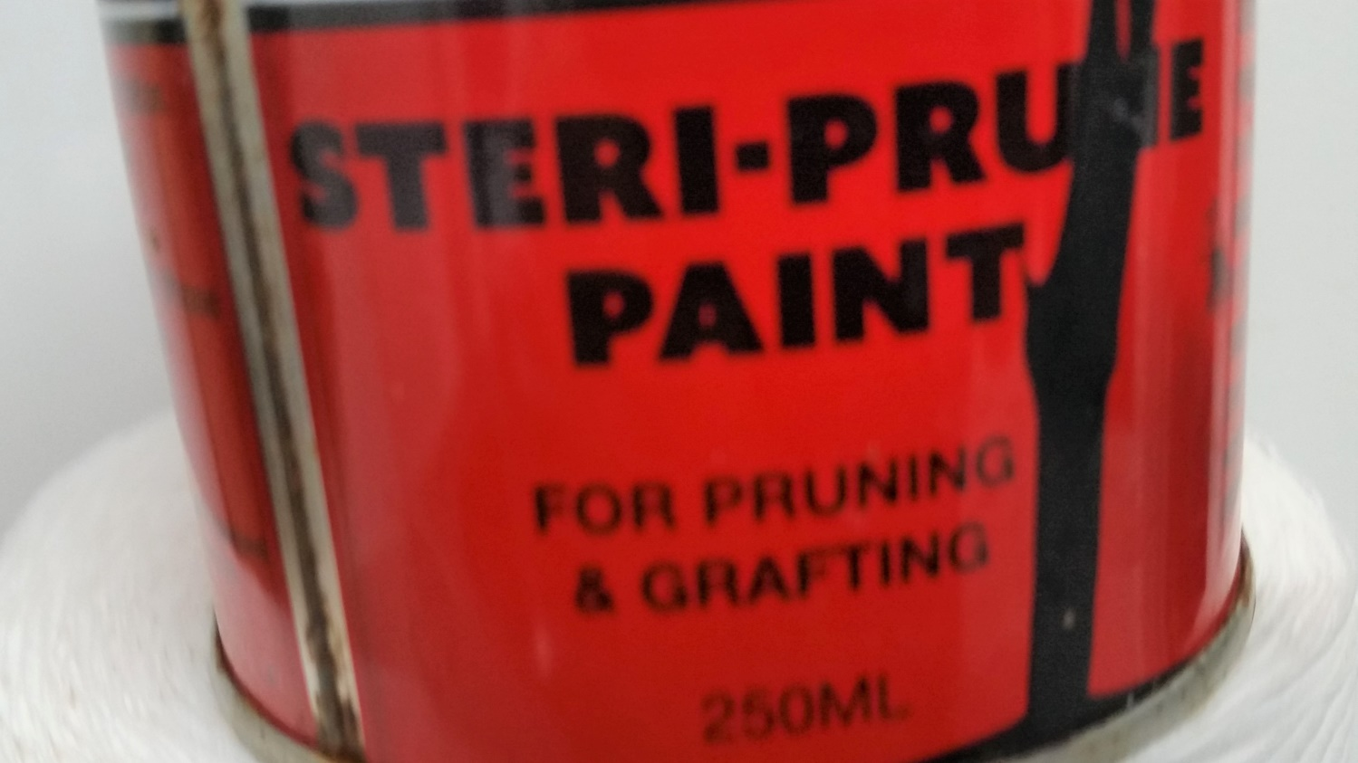
SEAL ALL CUTS WITH STERI-PRUNE USING A FRESH COTTON BUD ON EACH PLANT.

Slide 27
SPRAY WHOLE OF PLANT WITH A MIXTURE OF:-
5 mls of growth hormone, 5 mls Algenox, ¼ Aspro tablet per litre water,
concentrating spray on the root system

Slide 28
FEEDING TIME

Slide 29
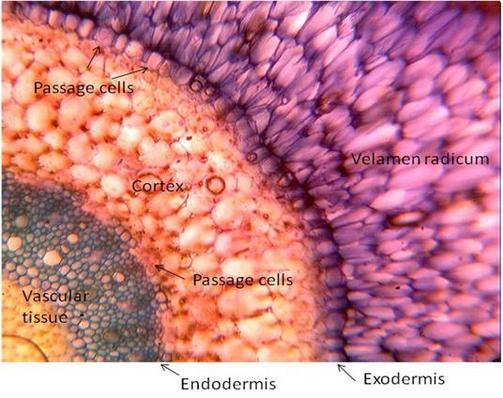
Microscopic View
Orchid root
Passage Calls
Velamen radicum
Cortex
Picture credit “ Zotz G & Winkler U. 2013. Aerial roots of epiphytic orchids: The velamen radicum and its role in water and nutrient uptake. Oecologia 171: 733-741”
Passage cells
Vascular Tissue

Slide 30
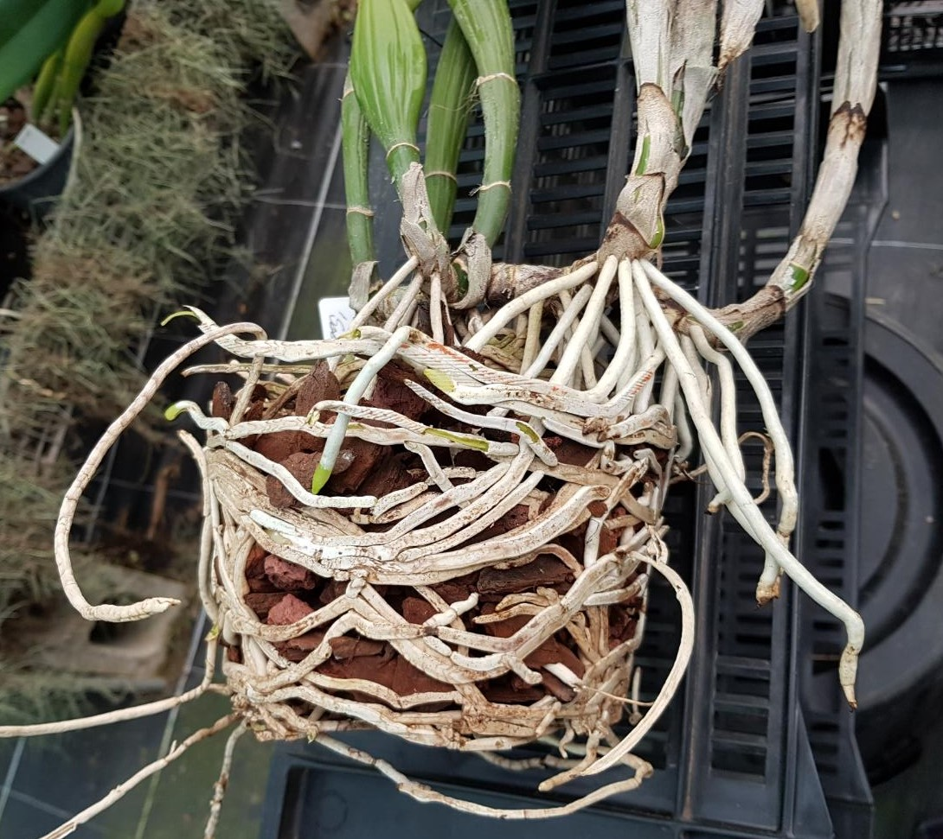
View of excellent
root growth

Slide 31
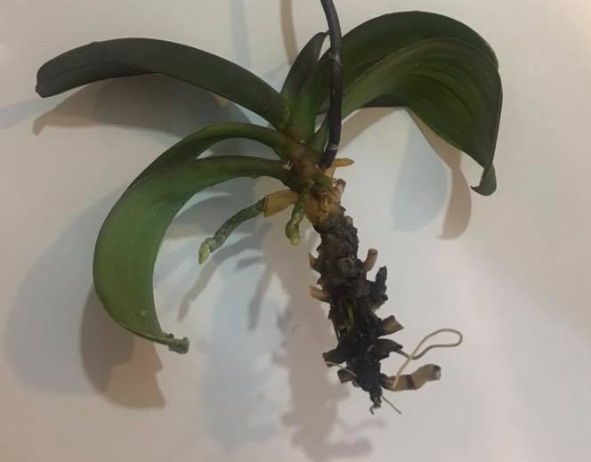
Very poor example of root growth,
caused by an excess of water and fertiliser

Slide 32
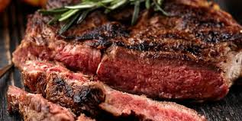

Slide 33
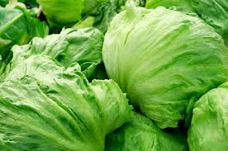

Slide 34
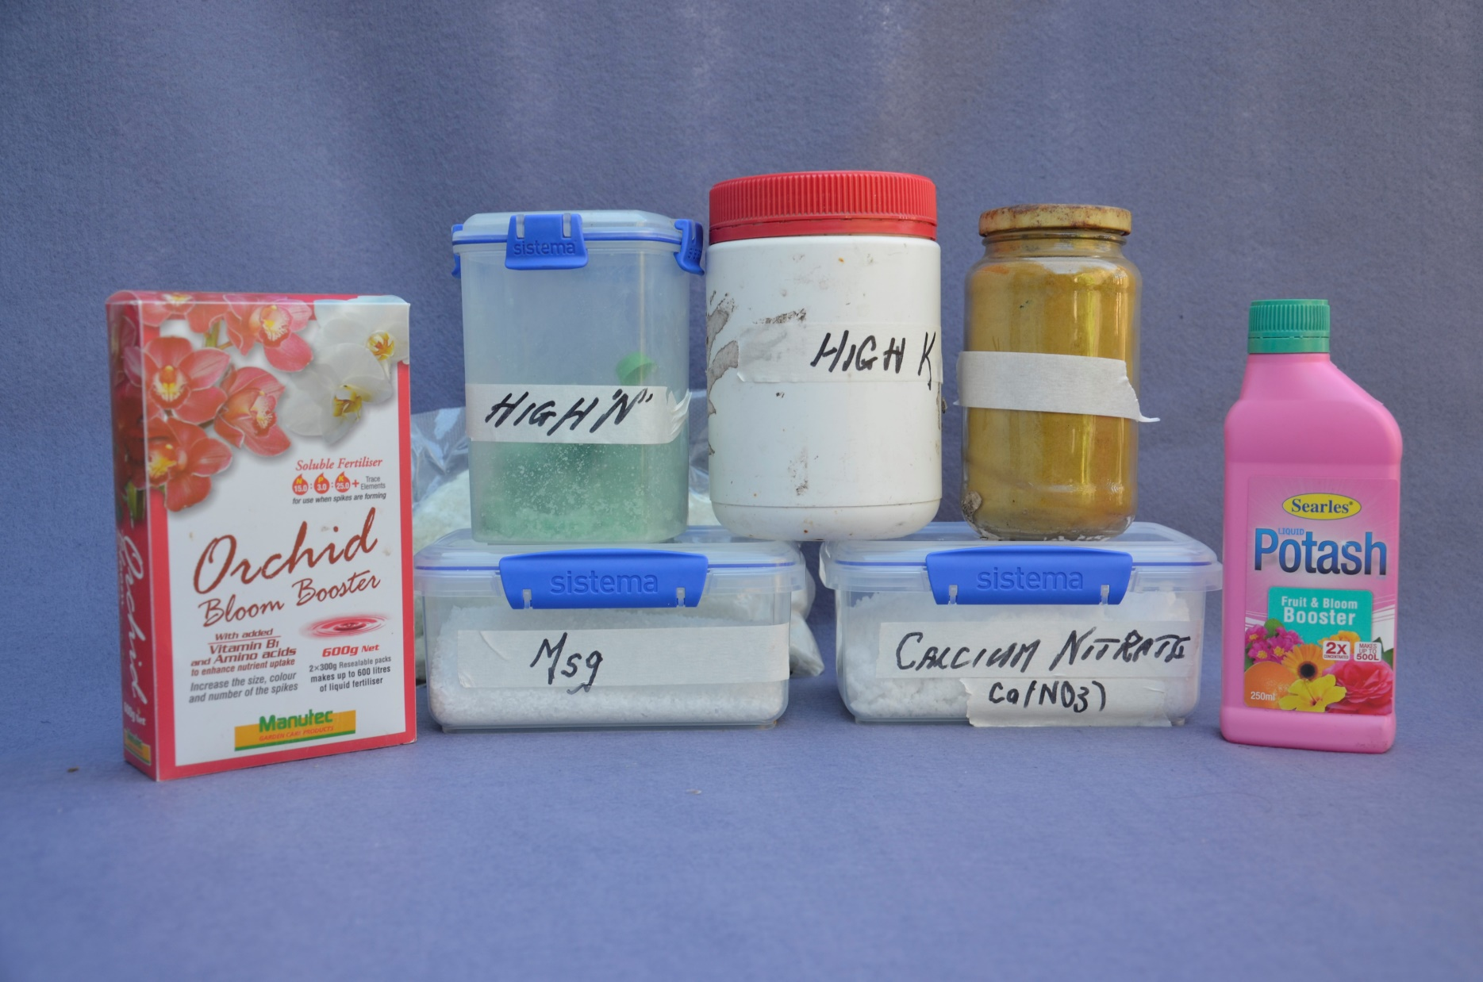
Chemical Fertilisers
Fe.
Notes:
YOU WILL NOTE A COMPLETE ABSENCE OF SLOW RELEASE FERTILISER IN THIS GROUP.

Slide 35
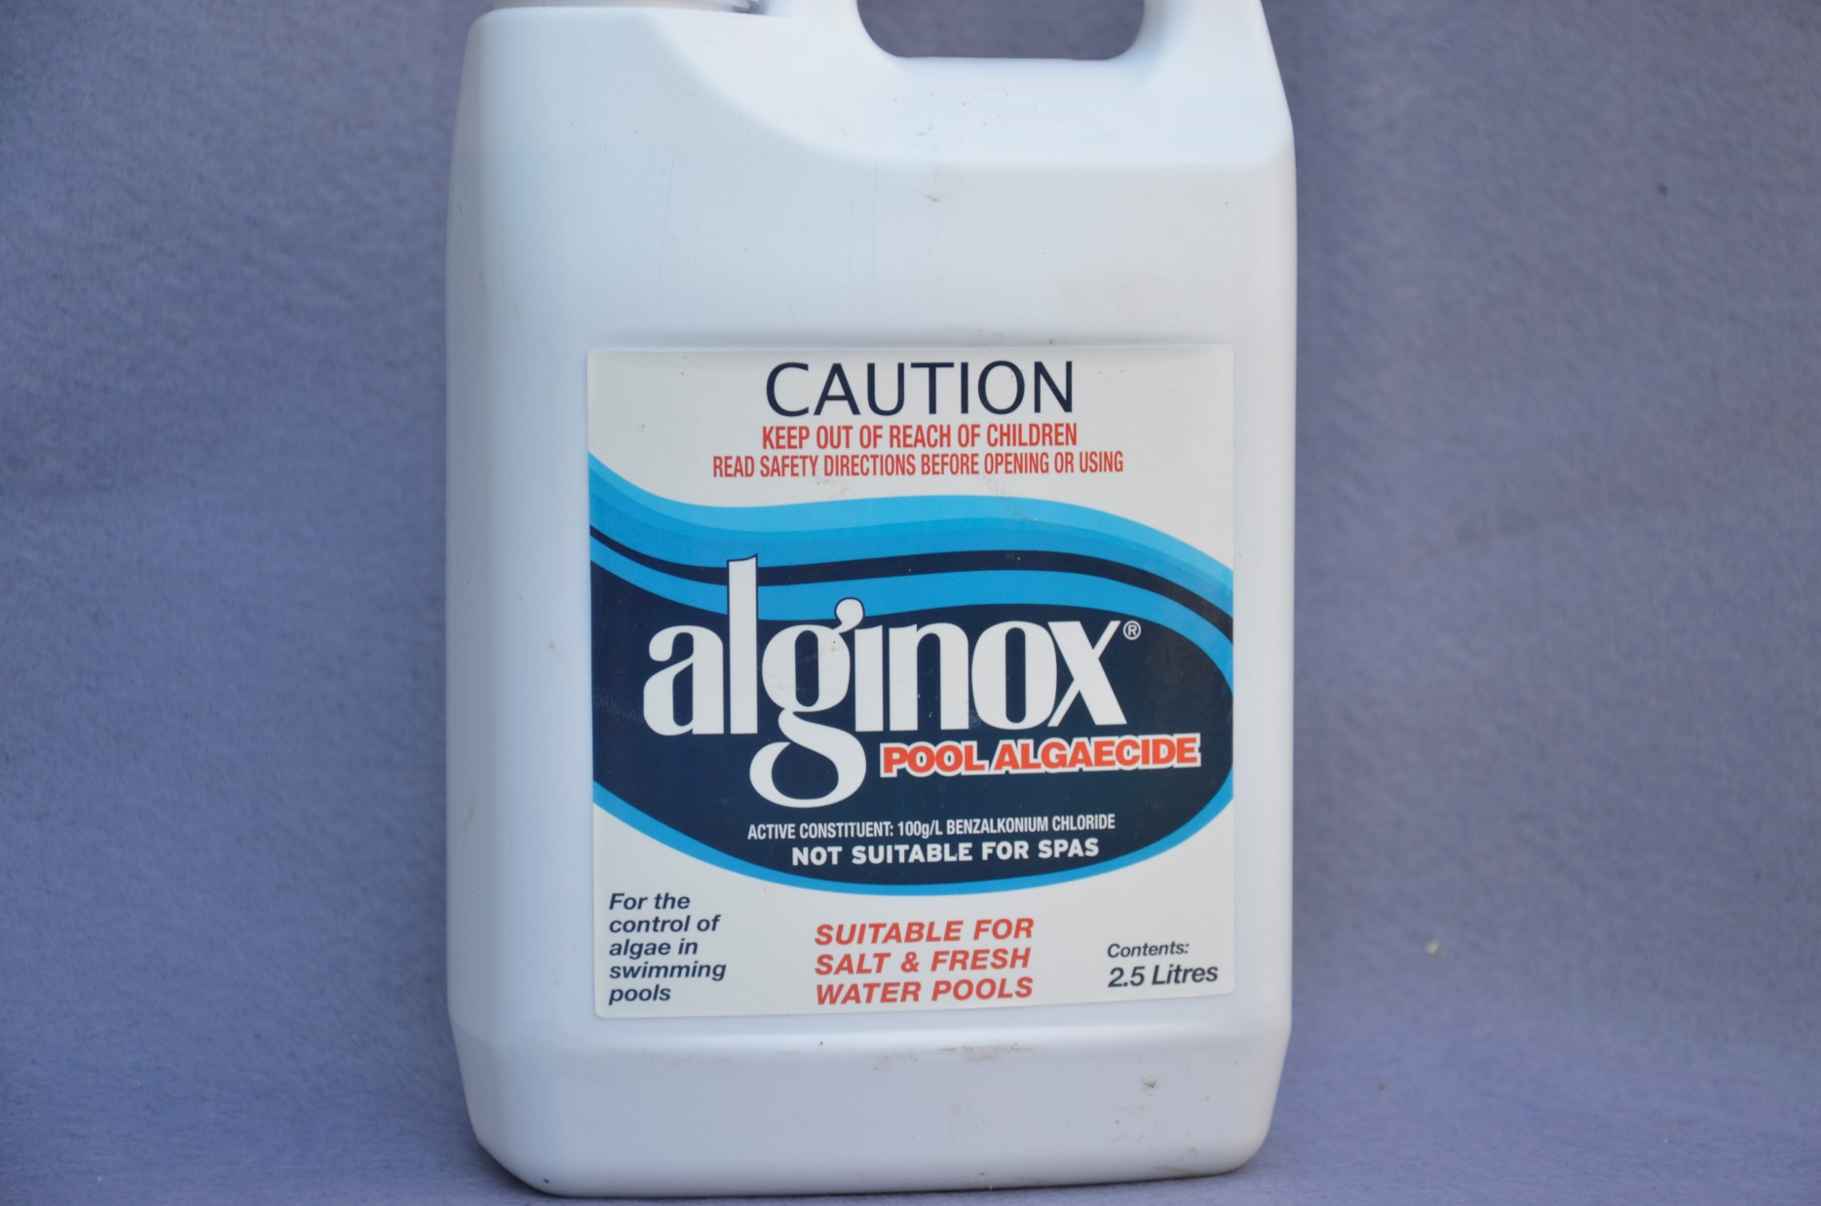
100gms per litre BENZALKONIUM
CHLORIDE

Slide 36
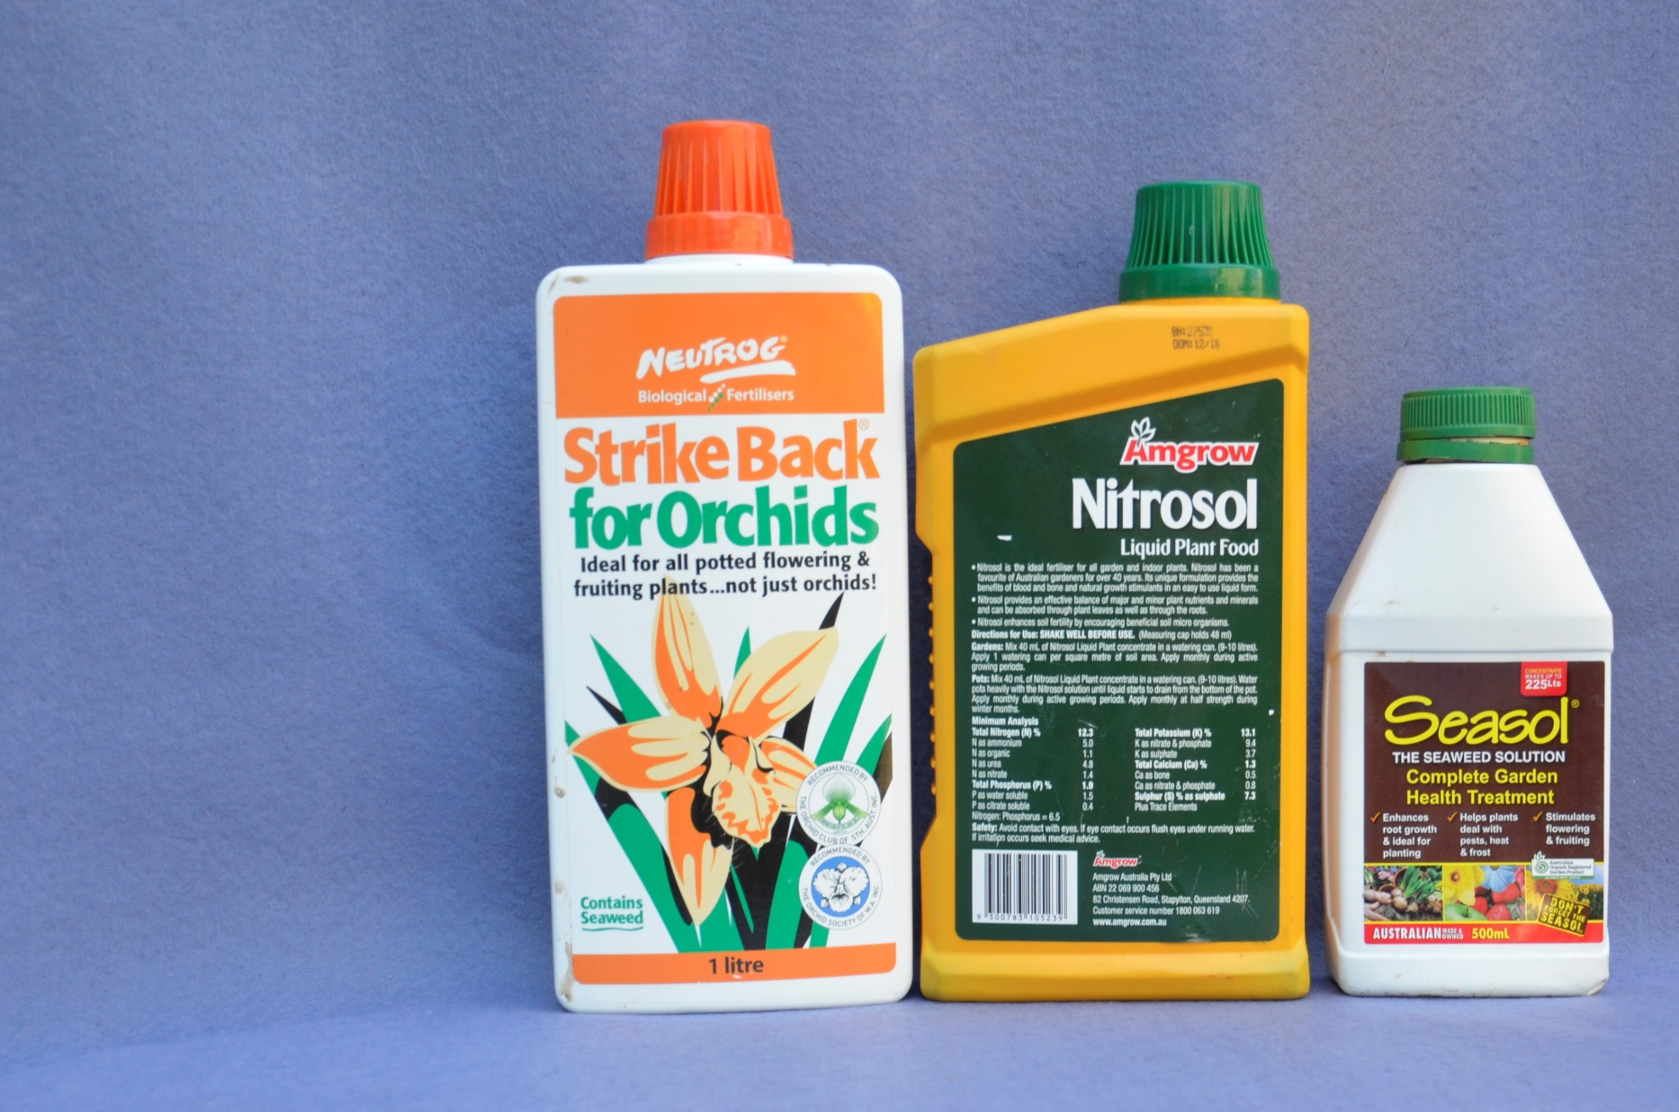
Organic Fertilisers

Slide 37
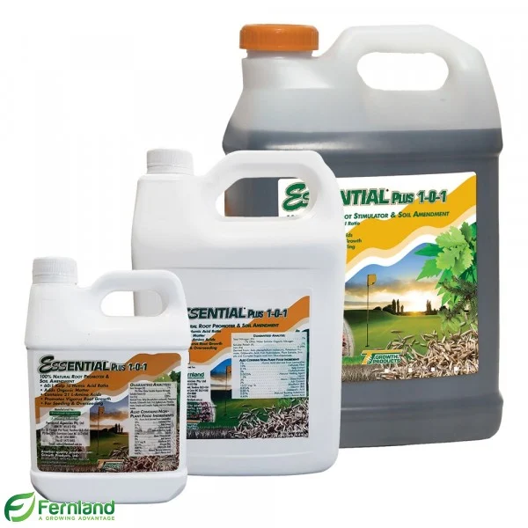
Growth Hormone

Slide 38
ASPRO
ONE TABLET TO 4 LITRES

Slide 39
HOW OFTEN SHOULD I FERTILISE?
Notes:
A QUESTION THAT YOU OFTEN ASK YOURSELF IS ‘HOW OFTEN SHOULD I WATER. AGAIN THERE ARE MANY theories going back to the slide on the root system this is what I do.

Slide 40
EVERY TIME I WATER
Notes:
At what time should I water. 22 March to 21 September during the morning, 22 September to 21 March of an evening. Stomata of leaf will absorbed fertilizer during the night.

Slide 41
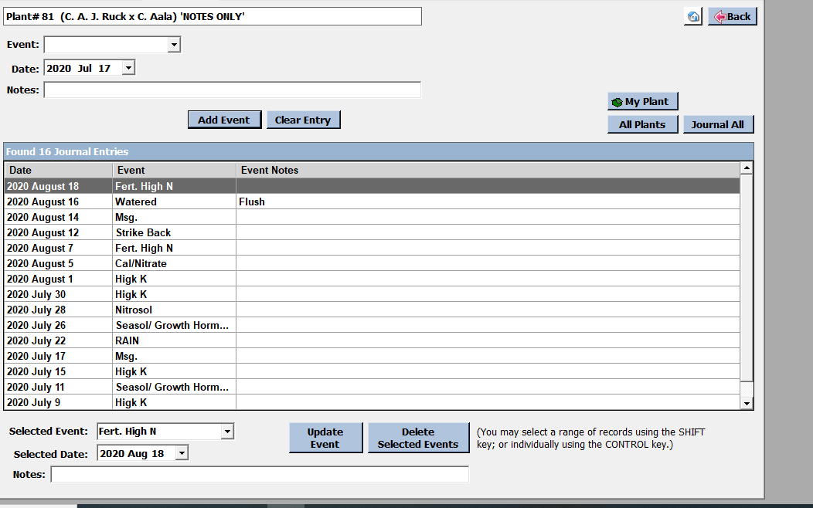

Slide 42
WHAT IS PH?
PH IS A MEASUREMENT WHICH DETERMINES THE AMOUNT OF HYDROGEN IONS IN A LIQUID,
ON A SCALE OF ZERO AND 14
with 7 being PURE water or neutral
below 7 being acidic
above 7 being basic (alkaline)

Slide 43
ALL LIFE ON EARTH IS CARBON BASED
BOTH ANIMALS AND PLANTS NEED ACIDIC BASED FLUIDS TO ALLOW UPTAKE OF NUTRIENTS TO THE VASCULAR SYSTEM
Human stomach acid has a PH of 1 Hydrochloric Acid has a PH of 1.2

Slide 44
FOR MOST ORCHIDS TO OBTAIN
THE MAXIMUM UPTAKE OF THE AVAILABLE ELEMENTS FROM THE FERTILISER, THE PH OF THE FERTILISER SOLUTION SHOULD BE IN THE RANGE OF 5.8 TO 6.5
TEST THE PH OF THE SOLUTION AFTER
THE MIX HAS BEEN COMPLETED.
Notes:
I WILL ALSO POINT OUT THAT BOTH FUNGUCIDES AND INSECTIDES SHOULD BE WITHIN THIS RANGE OF PH ALSO TO ALLOW THE EXTENTION OF THE EFFECTIVENESS OF THESE SPRAYS

Slide 45
TOWNSVILLE WATER SUPPLY
Most homes have Copper pipes. To save the pipes from corroding and making it necessary to replace them.
Council controls the acidity of the water supply by increasing its alkalinity. (This is a practice of all Councils)
To provide safe drinking water Council also adds Chlorine to the water supply.

Slide 46
WHAT IS THE SOLUTION ?

Slide 47
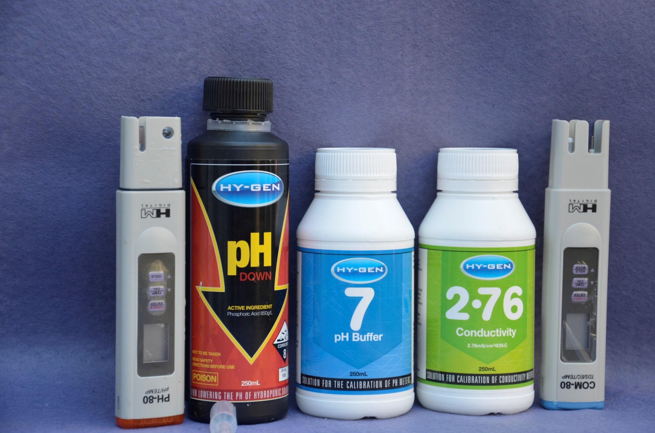
Phosphoric Acid
EC Meter
PH Meter
Notes:
North Queensland Hydroponics Casey Street Aitkenvale.

Slide 48
IMPORTANCE OF CALCIUM NITRATE
Ca(NO3)2
Ca is alkaline. Nitrogen oxide (NO3)2 consisting of 19 - 22 % nitrogen,
reduces the acidity of potting mix and provides additional nitrogen to counteract nitrogen loss in the decomposition of the bark.

Slide 49
Epsom Salts
Magnesium Sulphate MgSO4 7H2O
(heptahydrate)
is a soluble form of Magnesium which promotes healthy vegetable growth and aids increasing flower count.
NOTE: like all good things do not overuse.

Slide 50
